Slide 1
Image Sprite in CSS

Slide 2
What is a Sprite
Sprites are two-dimensional images which are made up of combining small images into one larger image at defined X and Y coordinates.
To display a single image from the combined image, you could use the CSS background-position property, defining the exact position of the image to be displayed.

Slide 3
Advantage of Using CSS Image Sprite
A web page with many images, particularly many small images, such as icons, buttons, etc. can take a long time to load and generates multiple server requests.
Using the image sprites instead of separate images will significantly reduce the number of HTTP requests a browser makes to the server, which can be very effective for improving the loading time of web pages and overall site performance.

Slide 4
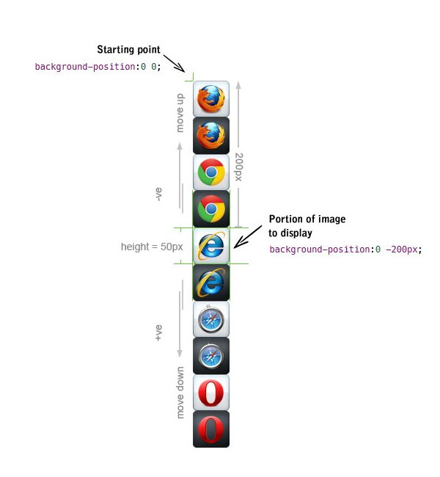
Making the Image Sprite
You can create your own sprite using any image editing tool you like.
The first value is the horizontal position, and second is the vertical position of background. As the upper-left corner of Internet Explorer icon touches the left edge so its horizontal distance from the starting point i.e. top-left corner of the image sprite is 0, and since it is placed on the 5th position so its vertical distance from the starting point of image sprite is 4 X 50px = 200px, because height of each icon is 50px.
the negative value makes it go vertically up whereas a positive value would move it down

Slide 5
Display an Icon from Image Sprite
Finally, utilizing CSS, we can display just the part of an image sprite we need.
First of all, create the class .sprite that will load our sprite image. This is to avoid repetition, because all items share the same background-image.
Now, we must define a class for each item we want to display. For example, to display Internet Explorer icon form the image sprite the CSS code would be.

Slide 6
<!DOCTYPE html>
<html lang="en">
<head>
<meta charset="utf-8">
<title>Example of CSS Sprite</title>
<style>
.sprite {
background: url("/examples/images/mySprite.png") no-repeat;
}
.ie {
width: 50px; /* Icon width */
height: 50px; /* Icon height */
display: inline-block; /* Display icon as inline block */
background-position: 0 -200px; /* Icon background position in sprite */
}
</style>
</head>
<body>
<span class="sprite ie"></span>
</body>
</html>

Slide 7
Creating a Navigation Menu Using CSS Image Sprite

Slide 8
<!DOCTYPE html>
<head>
<title>Example of Navigation Menu Based on Image Sprite</title>
<style>
ul.menu { list-style-type: none; }
ul.menu li {
padding: 5px;
font-size: 16px;
font-family: "Trebuchet MS", Arial, sans-serif;
}
ul.menu li a {
height: 50px;
line-height: 50px;
display: inline-block;
padding-left: 60px; /* To sift text off the background-image */
color: #3E789F;
background: url("../Images/mySprite.png") no-repeat; /* As all link share the same background-image */
}

Slide 9
ul.menu li.firefox a {
background-position: 0 0;
}
ul.menu li.chrome a {
background-position: 0 -100px;
}
ul.menu li.ie a {
background-position: 0 -200px;
}
ul.menu li.safari a {
background-position: 0 -300px;
}
ul.menu li.opera a {
background-position: 0 -400px;
}
ul.menu li.firefox a:hover {
background-position: 0 -50px;
}
ul.menu li.chrome a:hover {
background-position: 0 -150px;
}
ul.menu li.ie a:hover {
background-position: 0 -250px;
}
ul.menu li.safari a:hover {
background-position: 0 -350px;
}
ul.menu li.opera a:hover {
background-position: 0 -450px;
}
</style>
</head>
<body>
<ul class="menu">
<li class="firefox"><a href="#">Firefox</a></li>
<li class="chrome"><a href="#">Chrome</a></li>
<li class="ie"><a href="#">Explorer</a></li>
<li class="opera"><a href="#">Opera</a></li>
<li class="safari"><a href="#">Safari</a></li>
</ul>
</body>
</html>

